Slide 1
Introduction
Andrei Petrovski
( a.petrovski@rgu.ac.uk)
CM530– System Programming and Security

Slide 2
Overview
Introduction to the Module
Overview of x86 Virtualization
CPU Virtualization
Memory Virtualization
Device and I/O Virtualization
Summarizing the Current State of x86 Virtualization Techniques
Conclusion
School of Computing Science and DM, RGU

Slide 3
Module Aims
To review the design, implementation and functioning of operating systems.
To provide the student with the ability to administer proficiently the resources provided by operating systems.
To enable the student to deploy secure infrastructure using common operating systems

Slide 4
Learning Outcomes
Demonstrate an understanding of the inner working of common operating systems.
Efficiently program the operating system by making direct system calls.
Demonstrate an understanding of the security features of common operating systems.
Design and implement secure systems using advanced operating system features.

Slide 5
Module Organisation
Activity | Details | Contact Hours
Lecture | Main Principles and Theory | 1hr per week
Labs | Practical techniques | 2hrs per week
Directed Study | Reading and Coursework Preparation | (roughly) 3 hours per week
Private Study | - | (roughly) 4 hours per week
Week 8 is ‘Assessment Week’
No Lectures or Labs.

Slide 6
Assessment
Exam
Closed book exam at the end of the semester
Coursework
Coursework assignments
50:50 Split (CW:Ex)
CW will be handed out later in the semester
Moodle Quizzes (optional)
Used to check your understanding of topics throughout the semester

Slide 7
Course Textbook
Elementary Information Security
Available on Amazon
http://tinyurl.com/o8ldavu

Slide 8
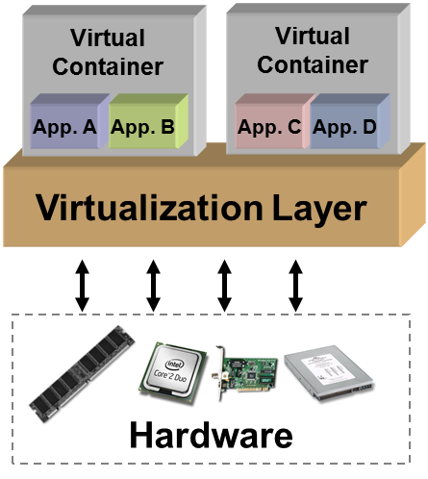
Introduction to Virtualisation
Creation of a layer that maps the interface of a system (virtual machine) or component (i.e., I/O device) onto the interface and resources of an underlying (possibly different) real system.
Purposes:
Abstraction
Replication
Isolation
Cross compatibility/Encapsulation
Does not necessarily aim to simplify or hide details.
Managed by a virtual machine monitor (VMM).
© 2008 Crossbeam Systems
Source: Mario Diaz– Virginia Tech University, 2009
School of Computing Science and DM, RGU

Slide 9
Virtualisation
Advantages:
Efficient use of resources
Cost and energy savings
Faults and threat isolation
Simple backup, recovery, replication
Disadvantages:
Compromised performance
Increased complexity and licensing costs
Single point of failure
School of Computing Science and DM, RGU

Slide 10
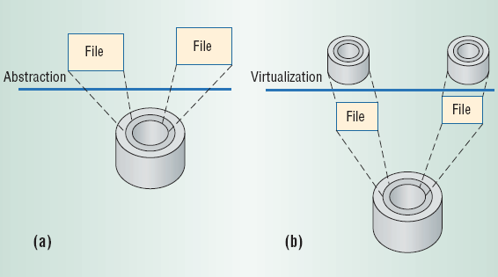
Abstraction vs. Virtualisation
Computer architecture benefits from Abstraction
Well-defined interfaces for hardware and software to use
E.g. Hard Drives, Networking, I/O devices
Limits based on the hardware implementation
Virtualization
Maps interfaces and resources to various hardware, even different architectures
School of Computing Science and DM, RGU

Slide 11
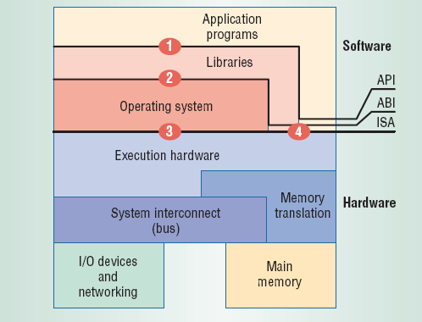
Architecture Interfaces
Virtualisation can take place at these junctures:
ISA – Instruction Set Architecture
ABI – Application Binary Interface
API – Application Programming Interface
School of Computing Science and DM, RGU

Slide 12
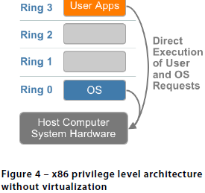
CPU Virtualization
User level applications run in Ring 3, the operating system needs to have direct access to the memory and hardware and must execute its privileged instructions in Ring 0.
Virtualizing the x86 architecture requires placing a virtualization layer under the operating system to create and manage the virtual machines that deliver shared resources.
VMware resolved the challenge in 1998, developing binary translation techniques.

Slide 13
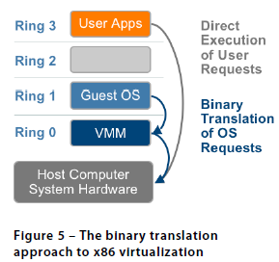
Technique 1: Full Virtualization using Binary Translation
Translates kernel code to replace nonvirtualizable instructions with new sequences of instructions that have the intended effect on the virtual hardware.
User level code is directly executed on the processor for high performance virtualization.
The guest OS is not aware it is being virtualized and requires no modification.
Full virtualization offers the best isolation and security for virtual machines.

Slide 14
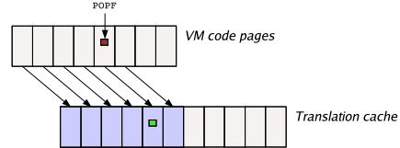

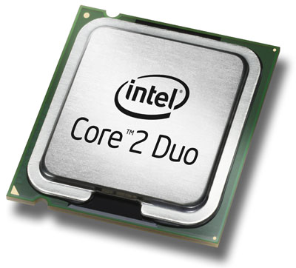
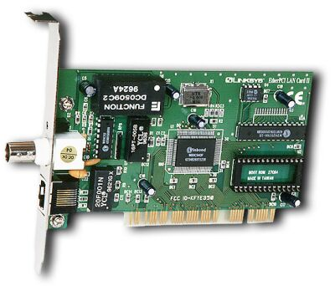
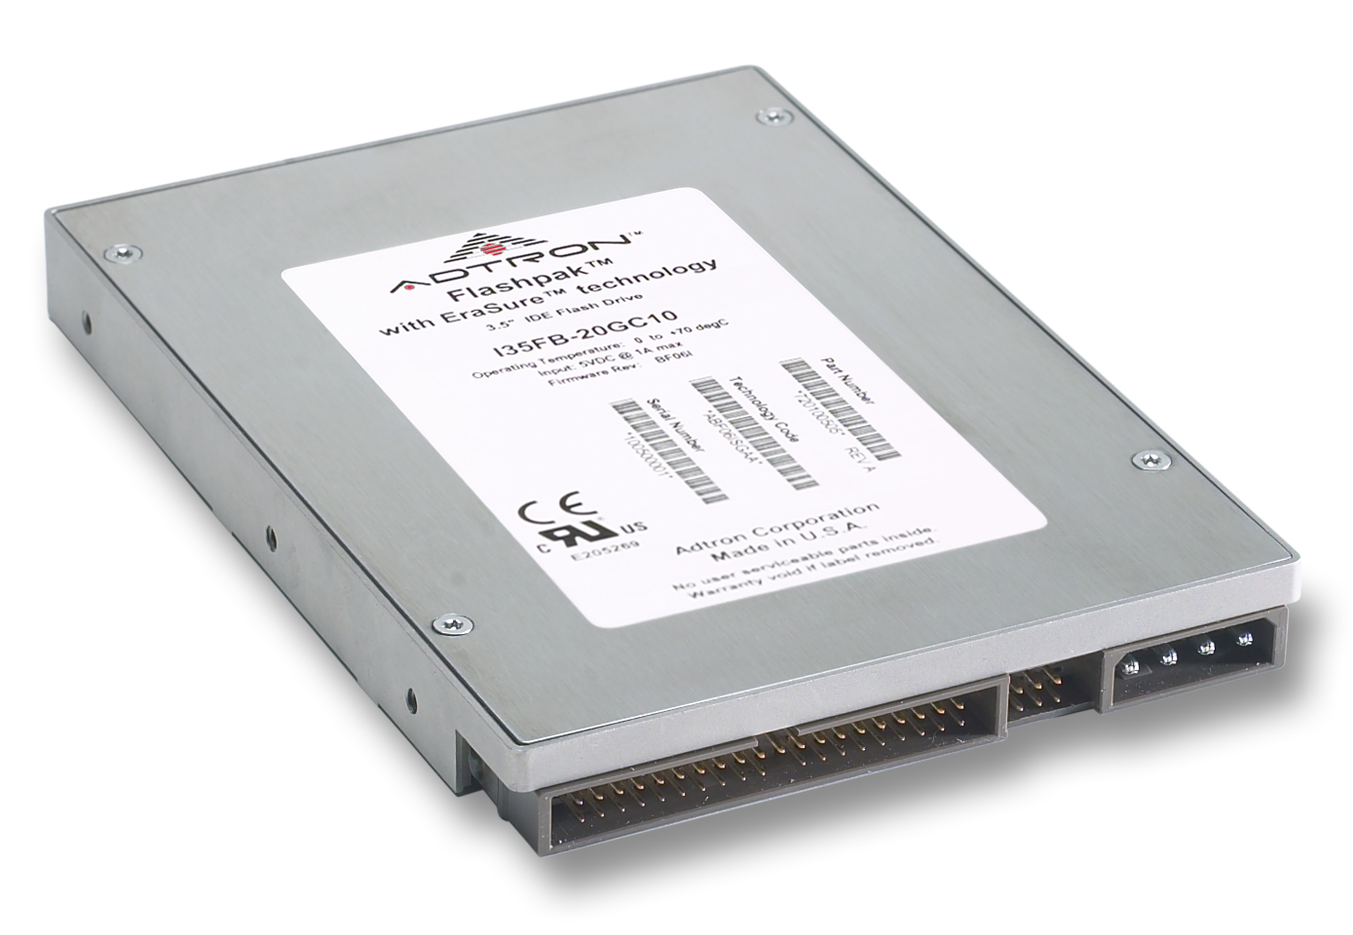
Virtualisation Approaches - VMWare
VMWare uses binary translation (full virtualisation), i.e.
Code running in each VM is scanned on-the-fly for “non-virtualizable” instructions and is rewritten into a safe form
It can also directly inline VMM functionality into the VM code – e.g., fast versions of I/O processing code
Virtual
Machine
Virtual
Machine
…
Dynamic Translation
Operating System
Hardware
VMM maintains a translation cache of recently-rewritten code pages
avoids high overhead for rescanning and rewriting on each execution pass
School of Computing Science and DM, RGU

Slide 15
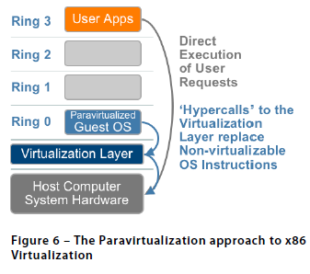
Technique 2:
Para – Virtualization/ OS assisted virtualisation
Modifying the OS kernel to replace non-virtualizable instructions with hypercalls that communicate directly with the virtualization layer.
Paravirtualization is different from full virtualization, where the unmodified OS does not know it is virtualized and sensitive OS calls are trapped using binary translation.
The performance advantage of paravirtualization over full virtualization can vary greatly depending on the workload.

Slide 16
Technique 2:
Para – Virtualization (cont.)
Paravirtualization cannot support unmodified operating systems (e.g. Windows 2000/XP)
The open source Xen project is an example of paravirtualization that virtualizes the processor and memory using a modified Linux kernel and virtualizes the I/O using custom guest OS device drivers
It is very difficult to build the more sophisticated binary translation support necessary for full virtualization, modifying the guest OS to enable paravirtualization is relatively easy

Slide 17
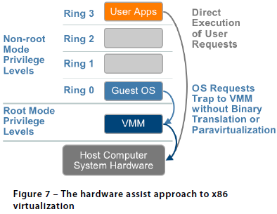
Technique 3:
Hardware assisted virtualisation
Intel Virtualization Technology (VT-x) and AMD’s AMD-V which both target privileged instructions with a new CPU execution mode feature that allows the VMM to run in a new root mode below Ring 0.
Privileged and sensitive calls are set to automatically trap to the hypervisor, removing the need for either binary translation or paravirtualization.

Slide 18
Memory Virtualization
The operating system keeps mappings of virtual page numbers to physical page numbers stored in page tables. All modern x86 CPUs include a memory management unit (MMU) and a translation look-aside buffer (TLB) to optimize virtual memory performance.
The guest OS continues to control the mapping of virtual addresses to the guest memory physical addresses, but the guest OS cannot have direct access to the actual machine memory.
The VMM is responsible for mapping guest physical memory to the actual machine memory.

Slide 19
Virtual Machines - Introduction
Operating systems abstract the physical hardware:
Thread abstraction: Each thread has its own “virtual CPU”
Process and address space: Each process has its own “virtual memory”
Filesystems: Each process has its own “virtual disk”
The OS interface is different than the physical machine:
Programs have to use system calls to request services from the OS
OS interface is much higher-level than the physical machine interface.
Example: Global names
All processes on a machine can see the same filesystem, though they may not have access to all of it.
This implies that processes are not truly isolated from each other.
School of Computing Science and DM, RGU

Slide 20
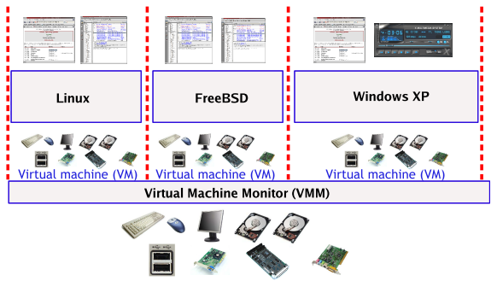
Virtual Machines - Concept
The concept of a VM introduces a layer above the hardware that:
Provides an illusion of a complete (virtual) physical machine
Allows multiple operating systems to run on the machine at once
Provides complete isolation and protection between VMs
© Matt Welsh – Harvard University, 2006
School of Computing Science and DM, RGU

Slide 21
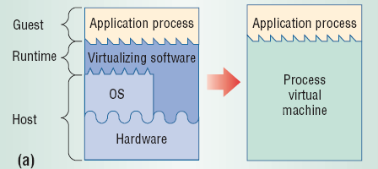
Process Virtual Machines
Virtualization below the API or ABI, providing virtual resources to a single process executed on a machine
Created for the process alone, destroyed when process finishes
Each application is given effectively separate access to resources, managed by the OS
Emulators and translators
Executes program binaries compiled for different instruction sets.
Slower, requiring hardware interpretation
Programs written for an abstract machine, which is mapped to real hardware through a virtual machine
Sun Microsystems Java VM
Microsoft Common Language Infrastructure, .NET framework
Source : K. Westrom, Auburn University, 2007
School of Computing Science and DM, RGU

Slide 22
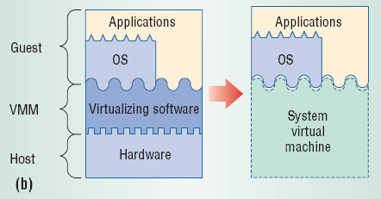
System Virtual Machines
Virtualized hardware below the ISA
Single host can run multiple isolated operating systems
Isolation between concurrent systems, security
Processor/resources timeshared
Quality-of-service isolation
Testing of insecure or questionable software and systems
Hardware - Managed by the Virtual Machine Manager
Classically, VMM runs on bare hardware, directly interacting with resources
Intercepts and interprets guest OS actions
Hosted VM
Installed application that relies on the OS to access hardware, using same ISA
e.g. VMWare Workstation
Whole System VM
Emulate both application and system code for different ISAs
e.g. Virtual PC, run Windows on old Mac hardware
Source : K. Westrom, Auburn University, 2007
School of Computing Science and DM, RGU

